Slide 1




CHAMPIONS LEAGUE FINAL 2010/11 SEASON BARCELONA | MANCHESTER UNITED
2011
WEMBLEY STADIUM – LONDON
FINAL 3 - 1
PEDRO RODRIQUEZ 27’
MESSI 54’
VILLA 69’
ROONEY 34’

Slide 2

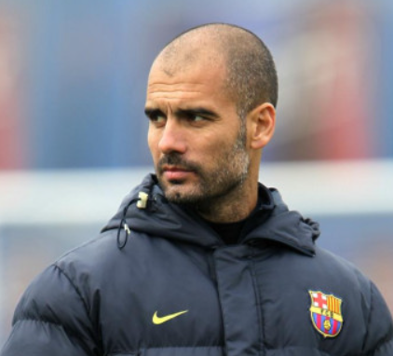
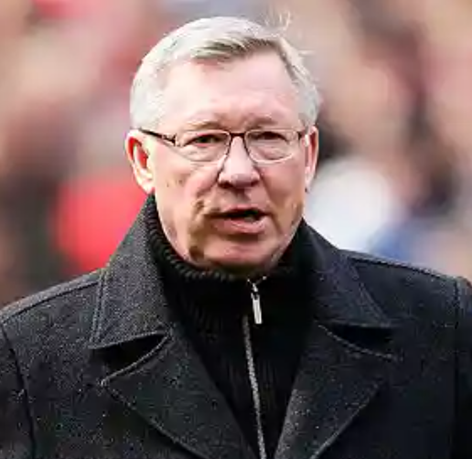
HISTORY
The 2011 Champions League final took place at the Wembley Stadium in London. Both teams were looking to add to their European success, looking for their fourth European Cup. Barcelona and Manchester united had met several times in recent history sharing an equal record of one win one draw and one loss each, the last time these teams met however it was Barcelona who left triumphant claiming their third European cup in the 2009 final in Rome. This game was highly anticipated, Ferguson was eager to take revenge over Pep after falling short previously, however Messi, arguably the greatest player in the world at the time would have something to say about that.
Pep Guardiola
Manager of Barcelona
Sir Alex Ferguson
Manager of Manchester United

Slide 3
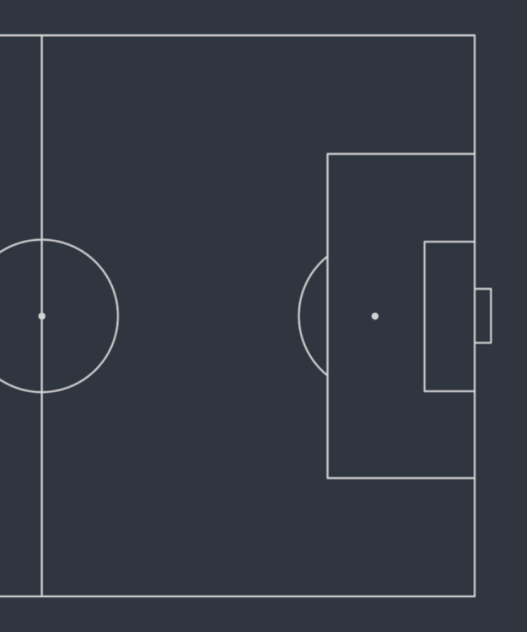
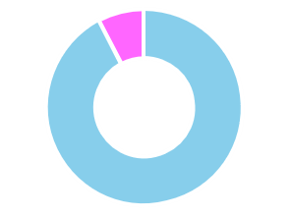
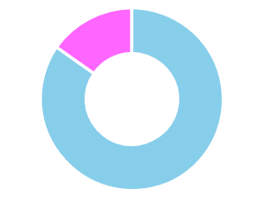
OVERVIEW | LINEUPS
4
1
Shots
Shots
On
Target
22
68%
32%
12

Slide 4
BARCELONA | TACTICAL ANALYSIS
1

Slide 5
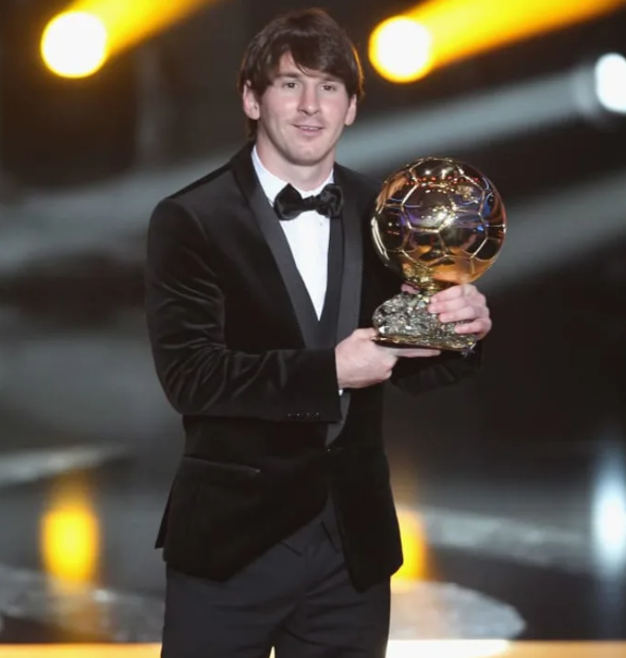
BARCELONA | KEY PLAYER
Lionel Messi | La Liga Stats | 2010/11
Average Assists Per 90
Lionel Messi
Cristiano Ronaldo
Average Goals Per 90
Data: Statsbomb via Fbref

Slide 6
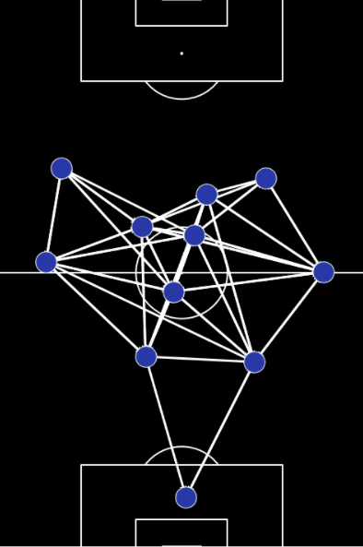
BARCELONA | 2011 UCL FINAL
Pass Network | 3 Pass Combination
Here we have Barcelona’s pass network until the first substitution. This map is extremely clear in terms of formation. There is a solid back four where the fullbacks are positioned high up the pitch, Busquets acts as a sole 6 in the middle of the park with Xavi and Iniesta playing as 8’s. Barcelona have their wingers high and Messi playing as a false 9 operating close to Xavi. This pass network displays a white line between players if there have been three or more passes between them, the amount of links in this network are very high with every player linking up with their surrounding players, this shows just how much emphasis Barcelona put on passing and holding possession. The tactical set up starts at the back with high fullbacks to create passing lanes, the midfield is extremely stacked with three holding the centre and Messi joining the tip, this allowed Barcelona to control the game dictating play with the control of the midfield. Barcelona then positioned their wingers high and wide to pin back United's full backs in order to create more space and overloads to operate in the centre of the pitch.
Lionel Messi False 9
Direction Of Play
Direction Of Play
Data: Statsbomb

Slide 7
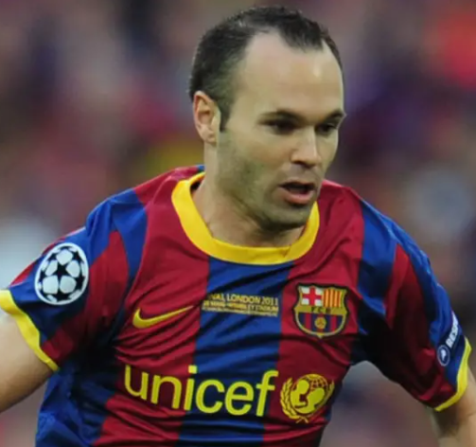
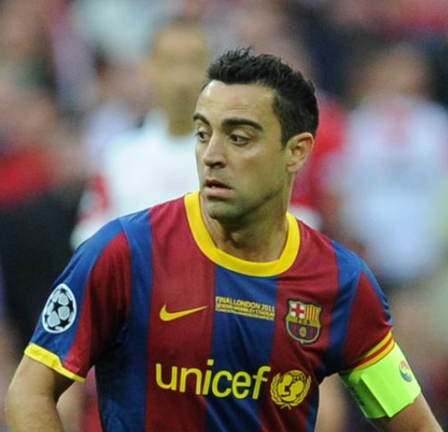
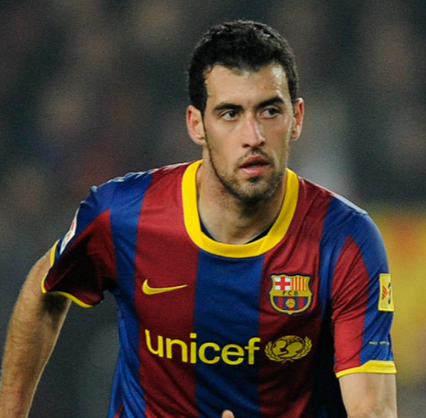
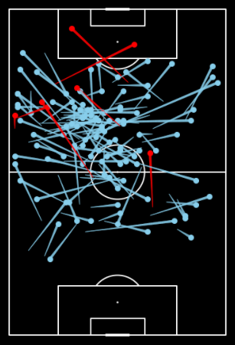
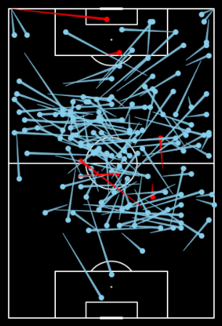
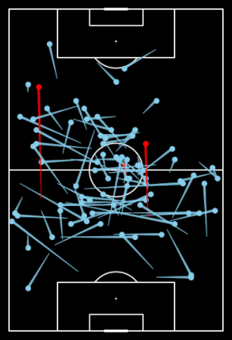
BARCELONA | 2011 UCL FINAL
Midfield Maestros | Successful/Unsuccessful Pass Map | Iniesta | Xavi | Busquets
107
7
144
6
78
3
These pass maps all show a similar trend of short high percentage passes to retain the ball
Barcelona were able to retain the ball well, all these pass maps have very high successful to unsuccessful ratios
Direction Of Play
Direction Of Play
Data: Statsbomb

Slide 8
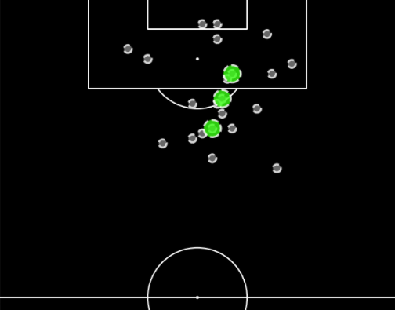
BARCELONA | 2011 UCL FINAL
Shot Map
Shots
Goals
Data: Statsbomb
This shot map from Barcelona shows a clear concentration of shots, this being in the centre and to the right half space. This area was clearly identified in a tactical plan where Barcelona could find space to get the shot away. This area is also where Messi liked to pick up when he dropped into the False 9 position as shown previously in the pass network Messi often occupied the tip of the midfield in this game. This meant that Barcelona could fully optimise Messi, not only his shooting ability which lead to a goal in this area but his link up play with other to provide shot opportunities such as the David Villa goal
Direction Of Play
Direction Of Play
22
3
Barcelona had the majority of their shots concentrated in the centre and the right half space from range. This is also where all of their goals came from
Shots vs Goals

Slide 9
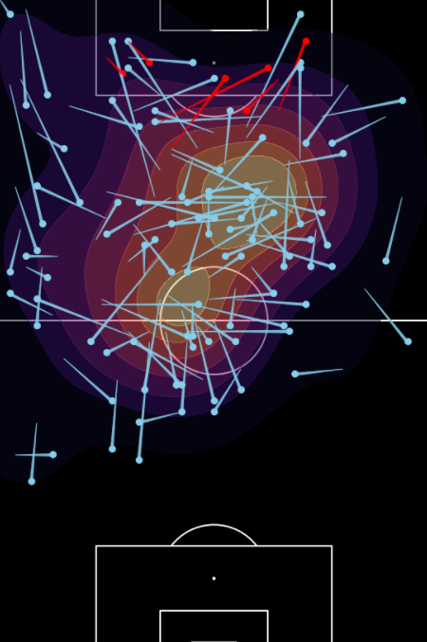
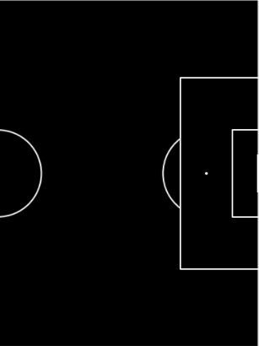



BARCELONA | 2011 UCL FINAL
Lionel Messi | Areas Occupied
Lionel Messi Heat Map
As shown in Messi’s heatmap he liked to pick up the ball in areas between the lines, dropping off from the number 9 position. United were unsure of how to handle this, either drop off and let Messi run at them or be drawn out, creating space for the wingers to run into, this is how the first goal came about as shown below with number 3 Patrice Evra being pulled out of position
Direction Of Play
Direction Of Play
Data: Statsbomb

Slide 10
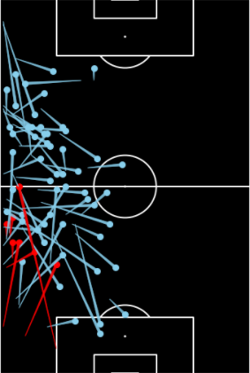
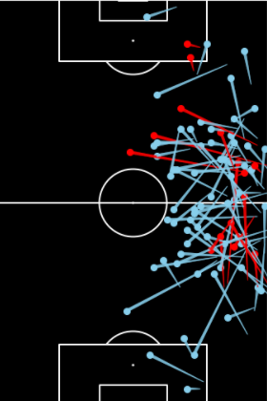
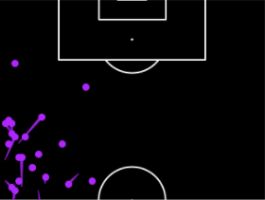
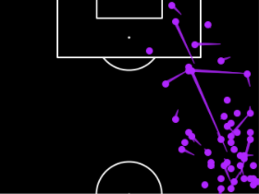
BARCELONA | 2011 UCL FINAL
Positional Play In Attacking Positions
Pass Map
Eric Abidal | Daniel Alves
Data: Statsbomb
These pass and carry maps show the actions of Barcelona full backs. Daniel Alves was seen as the best attacking full back in the world at the time, this attacking threat is shown on the maps with Alves having four actions within the United box, one being a cut back in the six yard box. Alves also had the most carries advancing into the oppositions half. Because of Alves’s attacking threat Ryan Giggs often had to track his runs, this meant that Giggs couldn’t tuck into the midfield in a defensive structure so Barcelona once again had a numerical advantage in the middle of the park. As previously explored the right inside channel was the space that became open, therefore Xavi and Messi could drift into the right half space to receive the ball in space or to get a shot away. This was exactly how Barcelona’s second goal came about
Direction Of Play
Direction Of Play
Carries Map
Eric Abidal | Daniel Alves
Direction Of Play
Direction Of Play

Slide 11
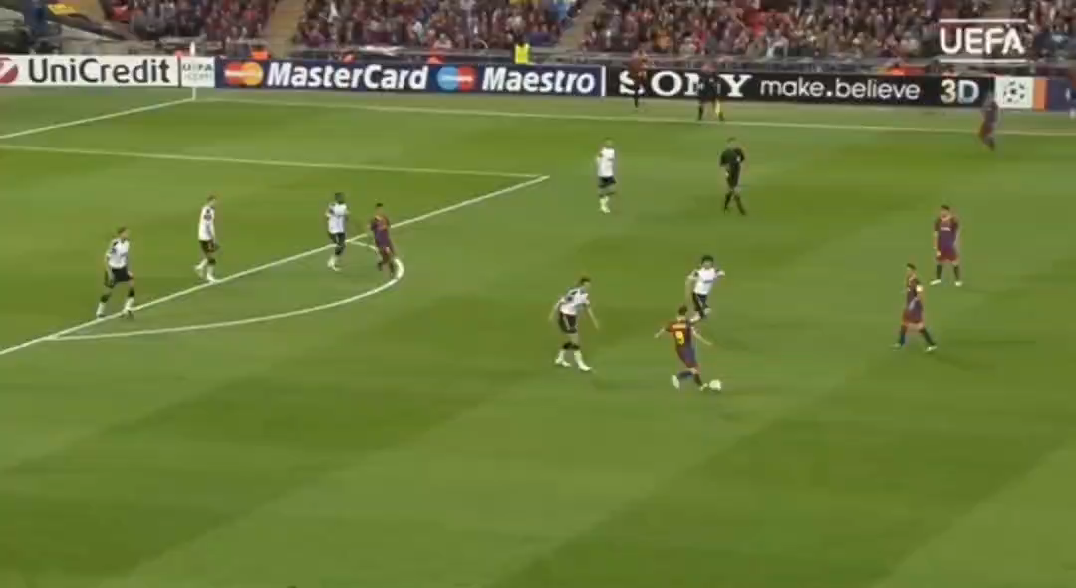
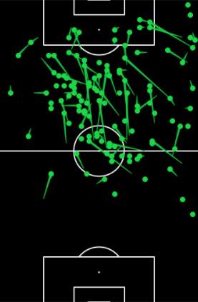
BARCELONA | 2011 UCL FINAL
Positional Play In Attacking Positions
Here is Messi’s carries in the oppositions half, this visualisation really puts emphasis on his ability to hold and drive with the ball at his feat
Data: Statsbomb
Carrying on from the previous slide this is the clip of Messi’s goal, the process of creating space in this area was repeated throughout the game, not only do we see the brilliance of Messi’s dribbling ability but also his ability to put the ball in the back of the net. In this passage of play we see how Evra was in fear of the previous goal and decided to hold the line until late, that is the threat of dealing with such player, you either commit to a challenge and face the risk of being beaten 1v1 or being passed around, or hold the line to keep the defensive structure however giving Messi the space to operate. We also see perfectly how Giggs was drawn wide to create the perfect pocket for Messi

Slide 12
MANCHESTER UNITED | TACTICAL ANALYSIS
1

Slide 13
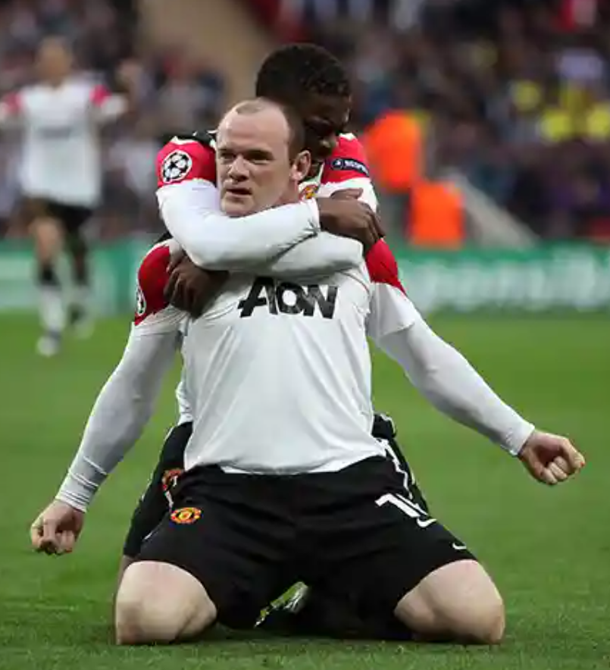
MANCHESTER UNITED | KEY PLAYER
Wayne Rooney | Premier League Stats | 2010/11
Average Assists Per 90
Wayne Rooney
Average Goals Per 90
Data: Statsbomb via Fbref

Slide 14
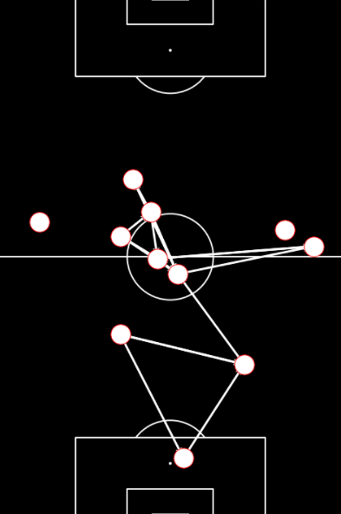
MANCHESTER UNITED | 2011 UCL FINAL
Pass Network | 3 Pass Combination
Here we have Manchester United’s pass network until the first substitution. This map is very different from the Barcelona one, there isn’t so much of a clean structure and the amount of passes are extremely sparce in comparison. The structure we can make out, is that the two centre halves sat slightly deeper than Barcelona’s and the midfield doesn’t follow a strict structure, however it is evident that the left midfielder often tucked in whilst Valencia provided the width. This pass network does however stop including data fifteen minutes before Barcelona’s due to an earlier substitution, despite that, however, this structure shows United’s lack of control in the game and highlights how effective Barcelona were at pulling them around to dismantle any shape they may have had. This map shows the lack of control in this game and United’s inability to get on the ball and keep it, resorting to the most popular passing lane between the two centre halves as that is the only place where United could retain the ball before being pressed off it.
Direction Of Play
Direction Of Play
Data: Statsbomb

Slide 15
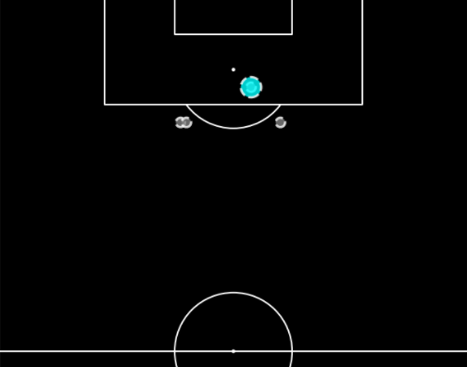
MANCHESTER UNITED | 2011 UCL FINAL
Shot Map
Shots
Goals
Data: Statsbomb
This shot map from Manchester United shows a sparce amount of shots, three of which were outside the box. This area is where Rooney liked to pick up as a number 10 and could arrive to balls being cut back to him from the wide midfield players. This tactic ultimately lead to a goal, as Giggs managed to advance beyond Rooney to cut back a pass which Rooney finished. Sir Alex being an attacking manager liked to push his players forward however Barcelona were so stacked in the midfield if United lost the ball they would quickly became outnumbered as Barcelona could just pass straight through them
Direction Of Play
Direction Of Play
4
1
Manchester United had the majority of their shots from range. These are low expected goal shots, this showing United's struggle to create good chances
Shots vs Goals

Slide 16
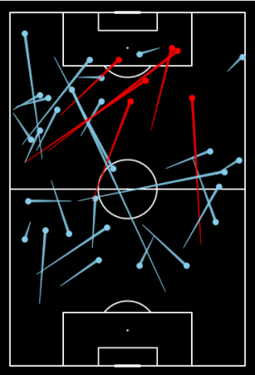


MANCHESTER UNITED | 2011 UCL FINAL
Attacking Areas Occupied
Ryan Giggs Pass Map
Rooney Assist
As shown in Giggs’s pass map he often found himself advancing up the pitch however reverting to long balls from the wing to find the striker or Rooney. Most of the time this was unsuccessful however some of these passes stuck, leading to Rooney's goal from his cut back following an attacking run. Many of Manchester United’s players bombed forward to try and overwhelm Barcelona, this time it paid off as Rooney slotted home
Direction Of Play
Direction Of Play
Wayne Rooney
Ryan Giggs
Data: Statsbomb

Slide 17
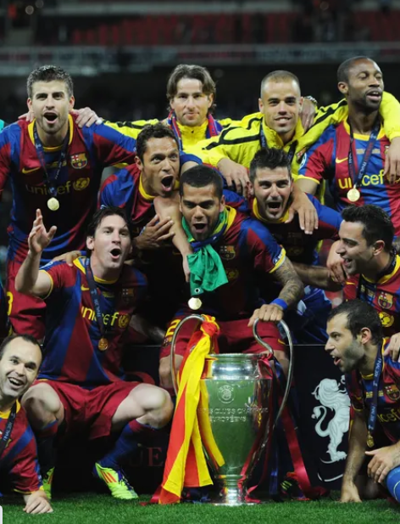
UCL 2010/11 SUMMARY
Barcelona vs Manchester United
1
The data collected and visualised in this report shows exactly how Barcelona were able to claim victory to the 2010/11 Champions League title. Throughout the game Barcelona were able to assert dominance on the ball and dictated the play through their tactical formation and midfield maestros. Manchester United were no match for Barcelona during the entire ninety minutes, even Sir Alex stating they were the best team he has ever faced. The reason behind the gap in quality could be down to several reasons, the first being the managers tactics, perhaps Pep got the upper hand in this duel due to his possession based tactics which aimed to pass teams to ‘death’ and United couldn’t compete with this or couldn’t gain control of the ball the way the manager would have liked. This links with the individual players quality, United’s team was far from its 2008 Champions League winning squad due to the likes of Ronaldo and Tevez moving on and a lack of investment to refresh the squad, United’s team also consisted of aging players such as Giggs and Scholes, who at the time were being out classed by the two number 8’s of Xavi and Iniesta. Barcelona’s victory could have also come down to the quality they had in their ranks with academy graduates instilled with the Barcelona style of play dictating the game, and of course Lionel Messi who was at the time the greatest player in the world.

